Slide 1


Slide 2

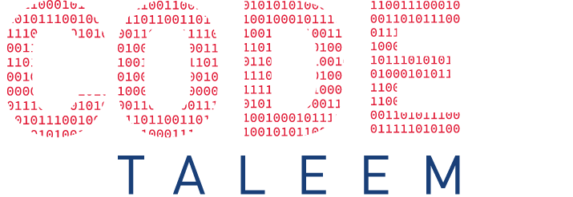

What is JavaScript
Why learn JavaScript
Where to use
CHAPTER 1
Introduction of JS
History JS
Benefits of JS

Slide 3
What is JavaScript
Why learn JavaScript
JavaScript was initially created to “make web pages alive”.
The programs in this language are called scripts. They can be written right in a web page’s HTML and run automatically as the page loads.
Where to use
History JS
Benefits of JS

Slide 4
What is JavaScript
It’s the most popular programming language
JavaScript is, without question, the default language of the internet.
JavaScript is Easy to Learn
JavaScript also Affects Big Data and the Cloud “JavaScript Object Notation (JSON) is the go-to standard for data exchanges on today’s internet.”
JavaScript is Versatile Front-end: Angular, React, Vue, etc.. Back-end: Node.js
Why learn JavaScript
Where to use
History JS
Benefits of JS

Slide 5
What is JavaScript
Why learn JavaScript
Create Interactivity between web page and User.
A JavaScript can be used to validate form data before it is submitted to a server.
JavaScript manipulate HTML and CSS, creating, removing and changing HTML, dynamically applying new styles to your page.
Dynamic Complex Web Application
Where to use
History JS
Benefits of JS

Slide 6
What is JavaScript
Why learn JavaScript
JavaScript was initially created to “make web pages alive”.
The programs in this language are called scripts. They can be written right in a web page’s HTML and run automatically as the page loads.
Where to use
History JS
Benefits of JS

Slide 7
What is JavaScript
Why learn JavaScript
JavaScript was initially created to “make web pages alive”.
The programs in this language are called scripts. They can be written right in a web page’s HTML and run automatically as the page loads.
Where to use
History JS
Benefits of JS

Slide 8
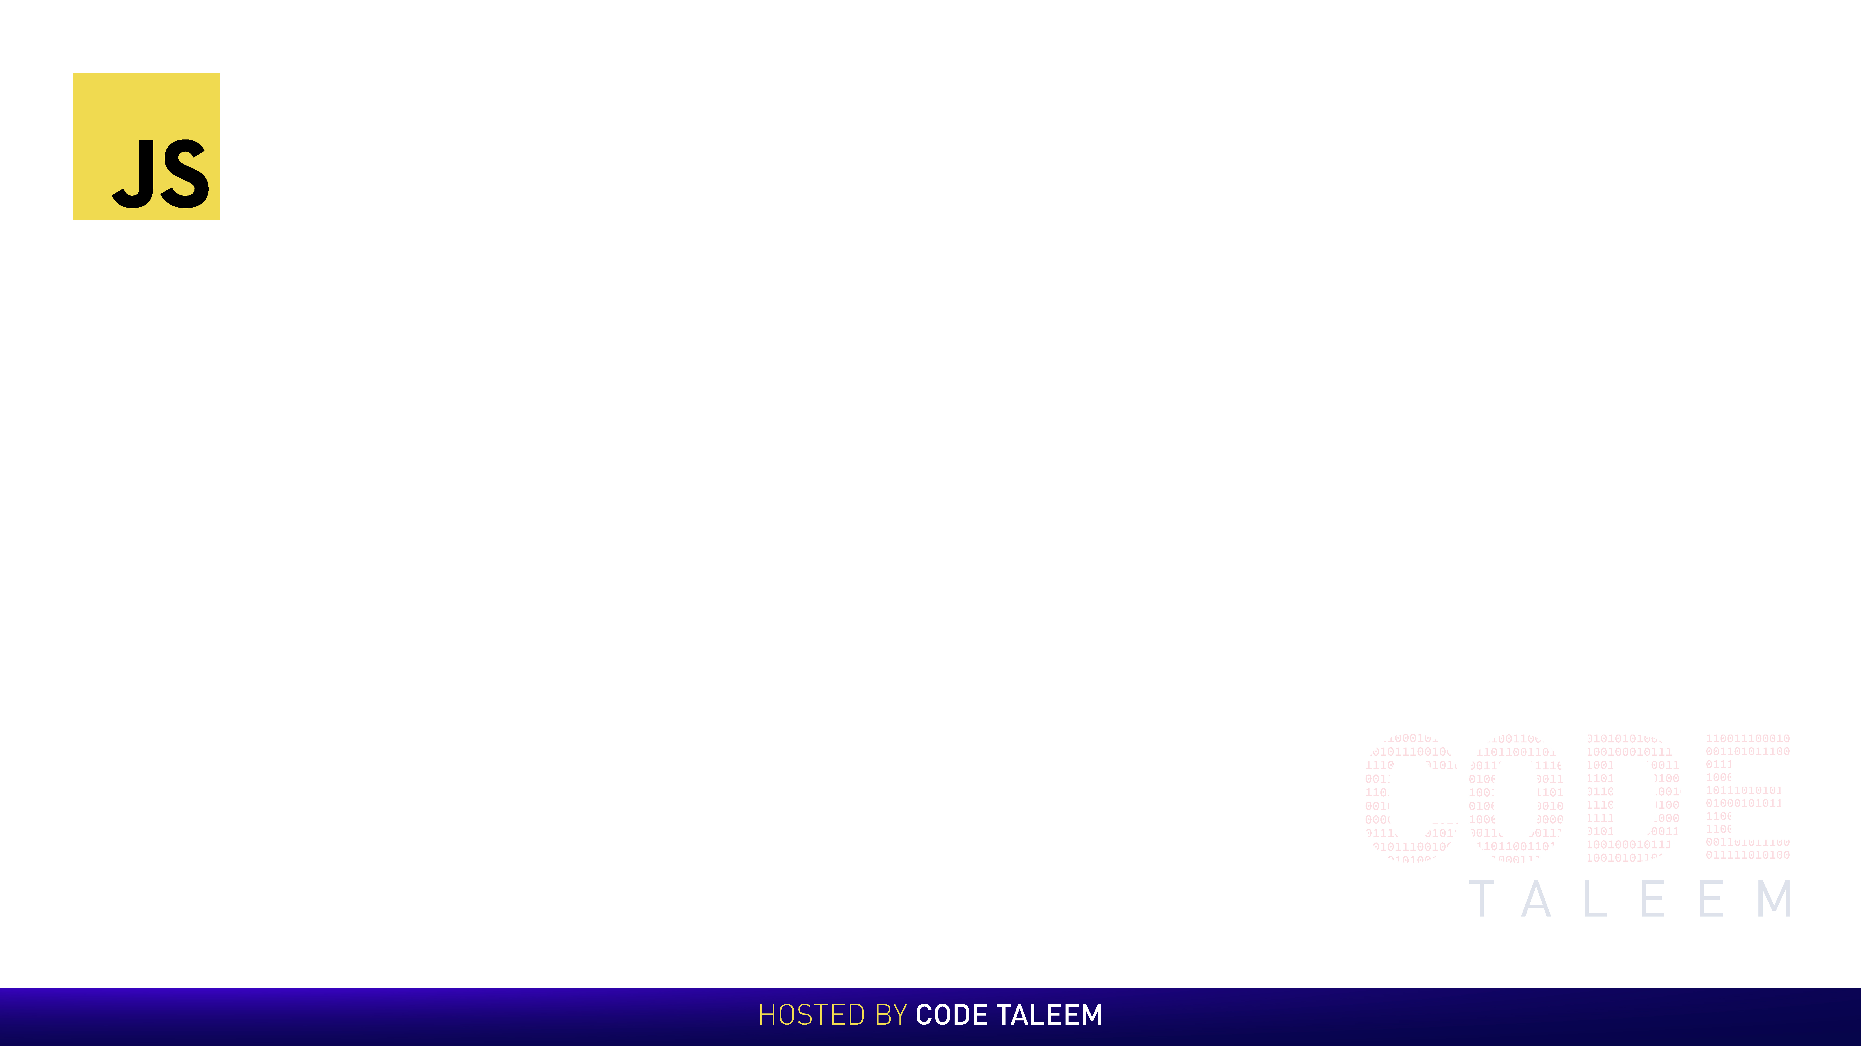
Chapter 1 - Introduction of JS
Video contains:-
What is JavaScript
Why learn JavaScript
Where to use
History JS
Benefits

